Slide 1
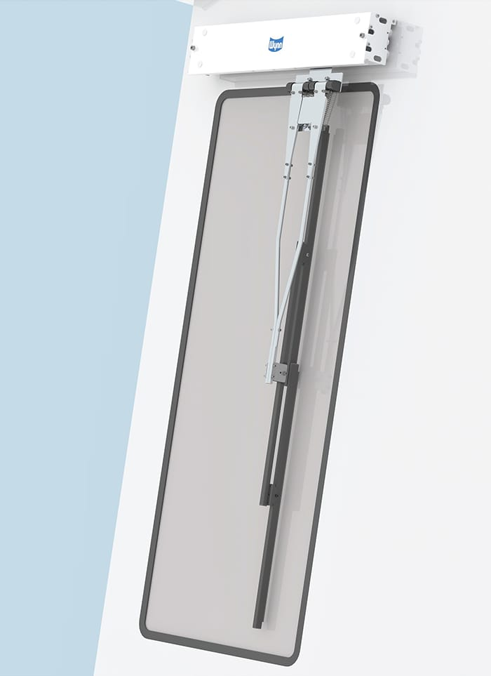
window wiper
img source:b-hepworth.com

Slide 2
GROUP MEMBERS:
Sandip kumar Burnwal
Rishav kumar
Ramresh Meena

Slide 3
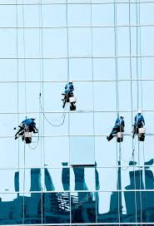
PROBLEM STATEMENT
CURRENTLY WINDOW CLEANINNG IS DONE IN LARGE BUILDINGS BY WORKERS.THEY NEED TO HANG FOR CLEANING THE WINDOW AND ALSO WINDOW CANNOT GET CLEAN AT REGULAR INTERVAL.

Slide 4

SOLUTION
WE WISH TO INSTALL A SIMPLE SYSTEM ATTACHED TO EACH WINDOW CONSISTING A WINDOW WIPER BLADE,CLEANING FLUID AND BASIC ELECTRONICS.WHEN SWITCH IS PRESSED ALL WINDOW IS CLEANED BY SPREADING CLEANING FLUID AND FOLLOWED BY A CLEANING SWIPE BY A WIPER.

Slide 5
About existing solution.
The wiper which are available needs to be run by humans or robots.there are various types of model available in the market in which wiper is fixed in the robot .There are different model also available some of the models are:
video link :-https://youtu.be/uRxxhHWdW3o video link https://youtu.be/IyD_-_L7CtM

Slide 6
PAST WORK IN THIS PROJECT
US PATENT NUMBER-5,515,570
ABSTRACT
A tool for wiping windows by means of a ceramic rectan
gular permanent magnet, or magnets, which has wiper
blades attached. This unit is called the slave unit. On the
opposite side of the window surface is a ceramic rectangular
permanent magnet or magnets, which is called the master
unit. When the two units are placed opposite each other
across the window surface the magnetic attraction pulls the
slave unit wiper blades against the window surface. When
the master unit is moved across the window surface, the
slave unit follows in unison on the other side and the wiper blades flip-flop wiping the window clear.

Slide 7
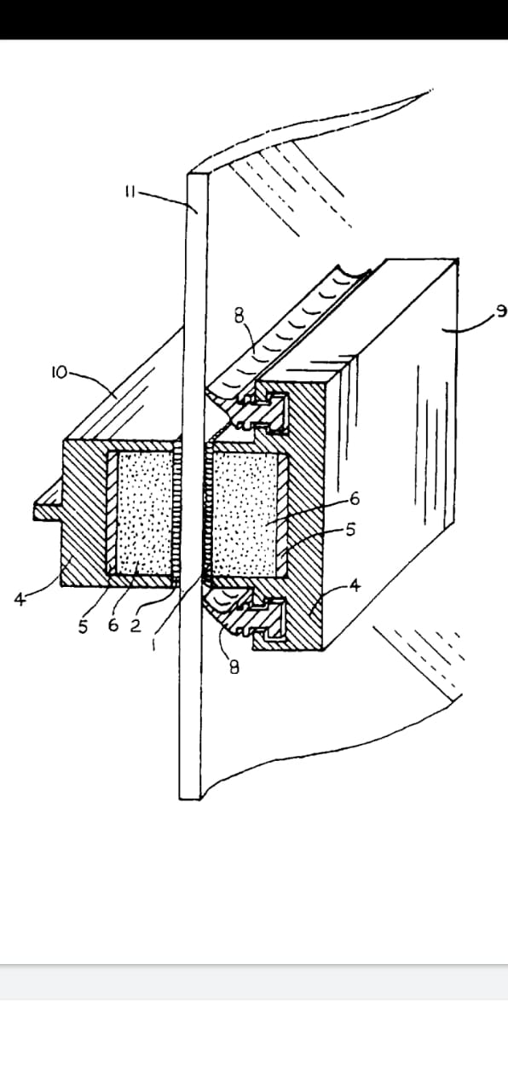
past model
WORKING METHOD

Slide 8
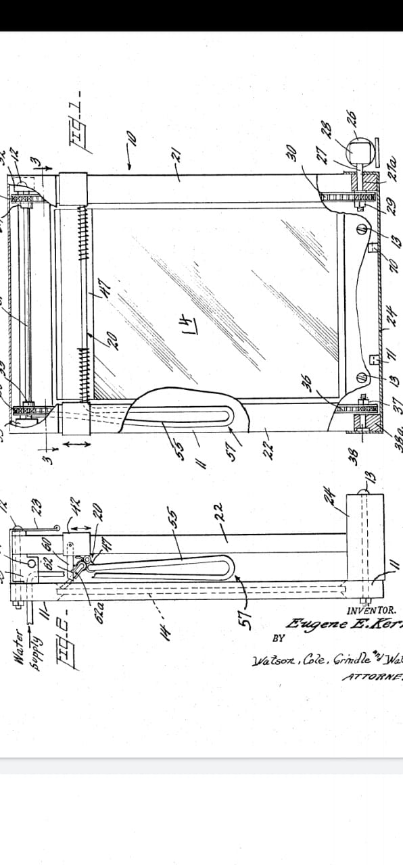
working method
working method

Slide 9
OUR IDEA!
WE IMPROVE THIS METHOD TO MORE ADVANCED AND AUTOTOMATIC SUCH THAT BY CLICKING TO THE SWITCH WIPER SPREAD THE FLUID AND AND WIPES THE GLASS WITHIN A FEW TIME.
WIPER IS ATTACHED TO THE CONVENTIONAL WINDOW FRAME AND IT WORKS when we press switch on.

Slide 10
working of window wiper
The cleaning mechanism includes one or more cleaning tools,Such as a brush and a wiper blade, and an onboard electric motor that provides the motive force for moving the cleaning mechanism.
we will fix the wiper to each window frame which is run by electric motor. the motor gets electricity from electric source and derives output mechanicalpower for rotating the drive wheels,which moves along the track.

Slide 11
Required items
electric motor
Valves
Wiper blade
Water pipes
Cranck shaft

Slide 12
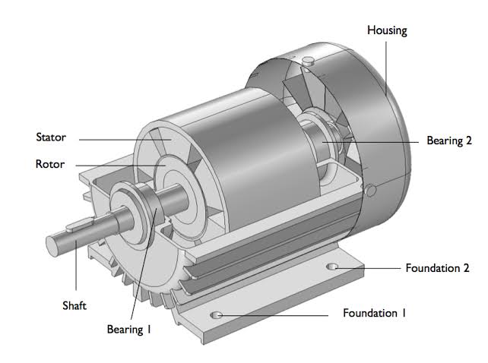
electric motor

Slide 13
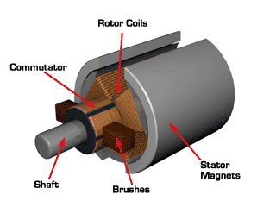
Animation

Slide 14
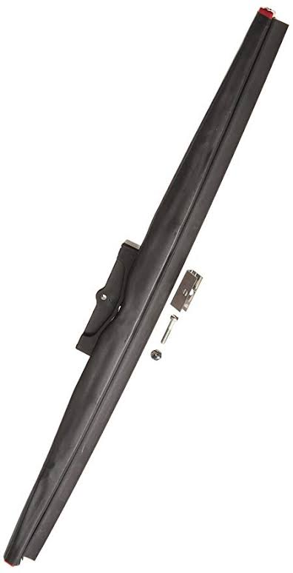
wiper blade
source:pininterest.com

Slide 15
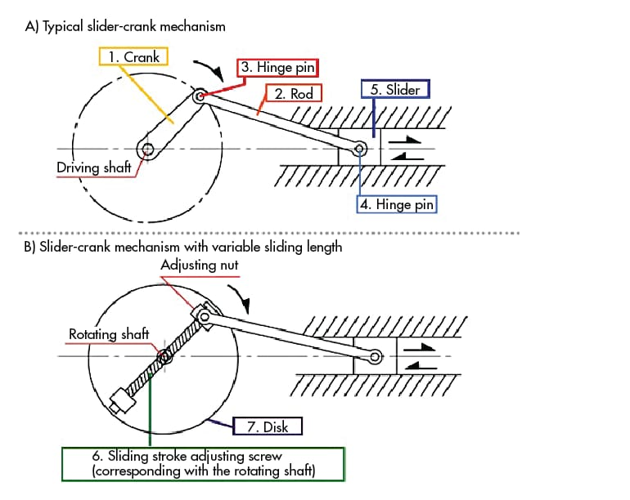
convertion of rotational motion into oscillatory motion

Slide 16
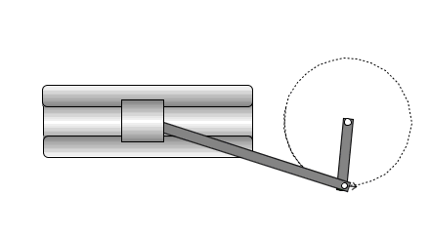
Animation
source:pinterest.com

Slide 17
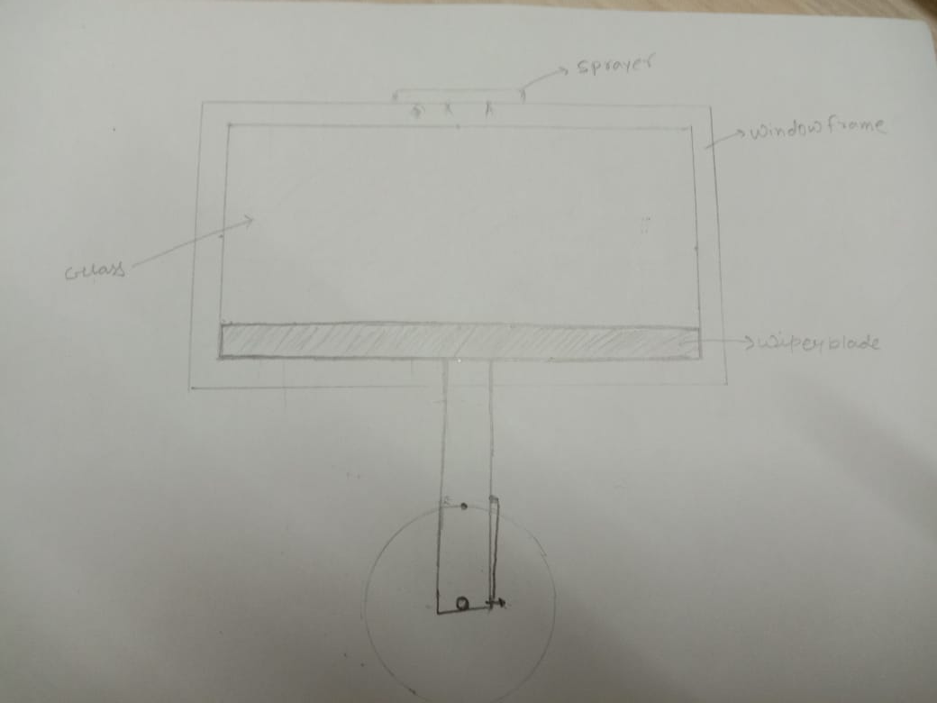
OUR DESIGN

Slide 18
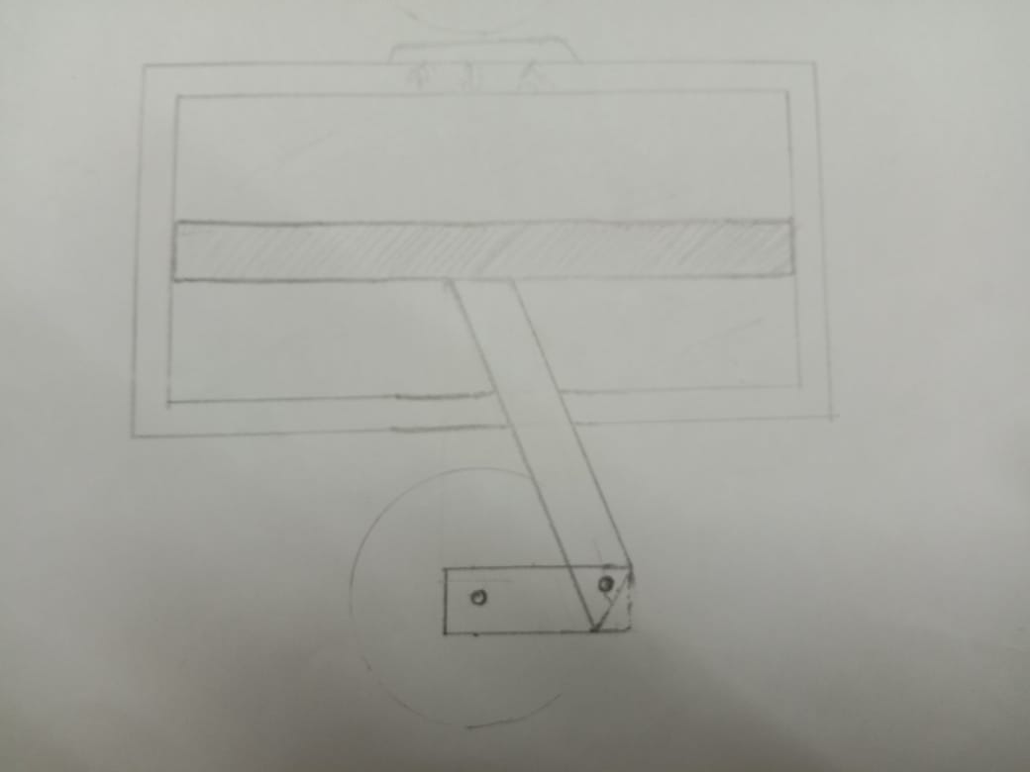

Slide 19
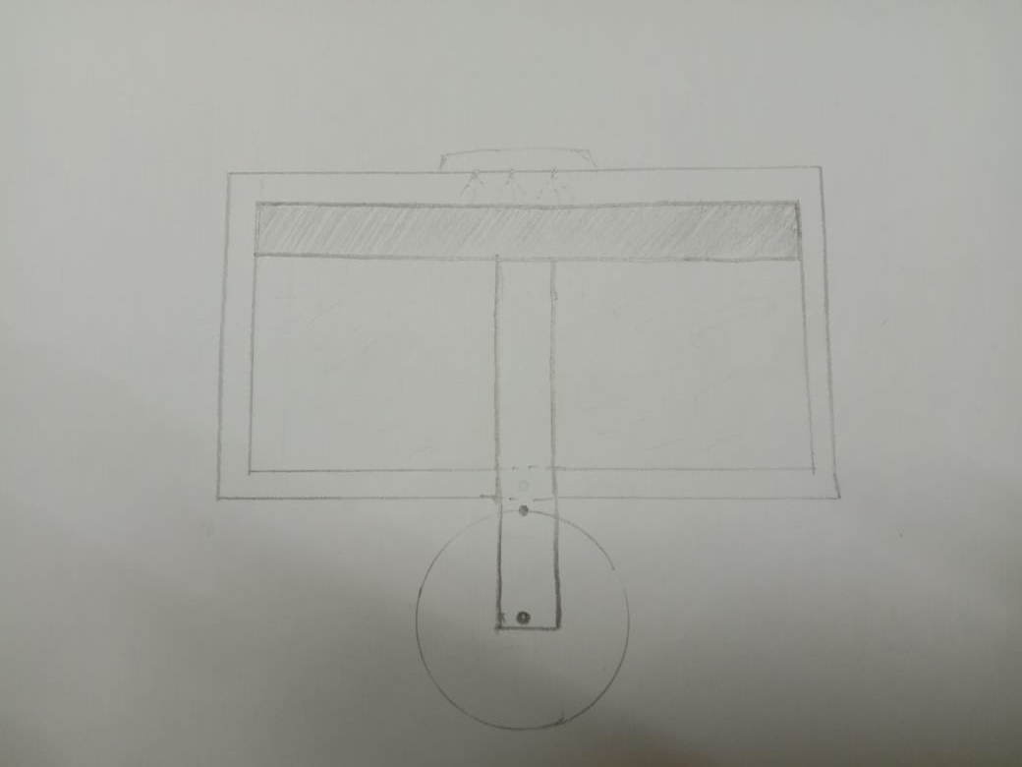

Slide 20
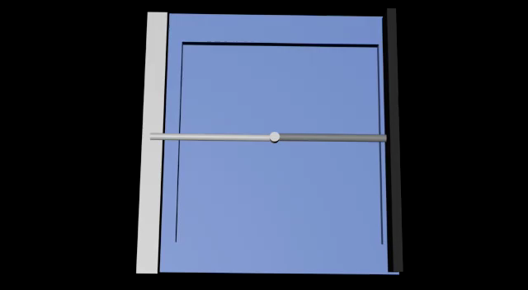

Slide 21
Techanical aspect in new feature and working of fluid spray for cleaning window.
wiper is run by electricity and it is automatic.For cleaning fluid it is conneted with water tank present at the top of the building.It is sprayed on the glass and glass gets clean by wiper.

Slide 22
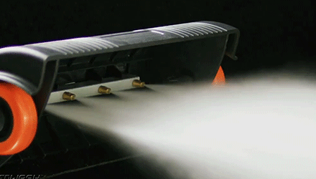
Animation of sprayer
source:pinterest.com

Slide 23
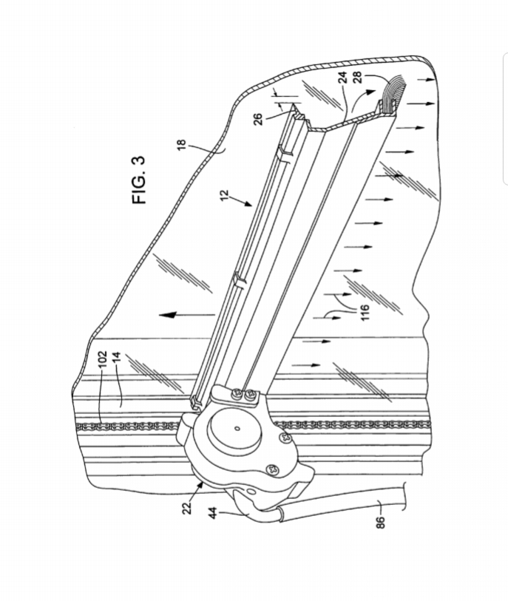
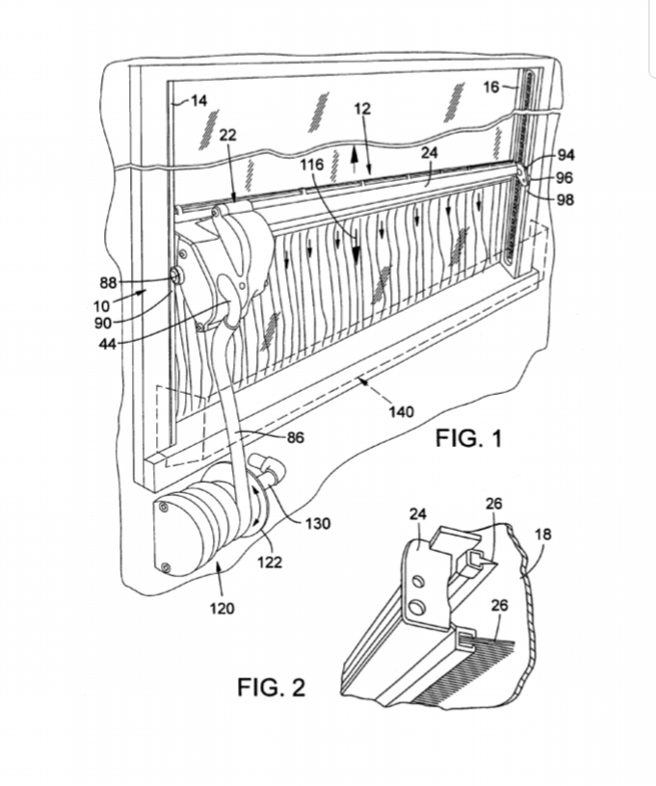
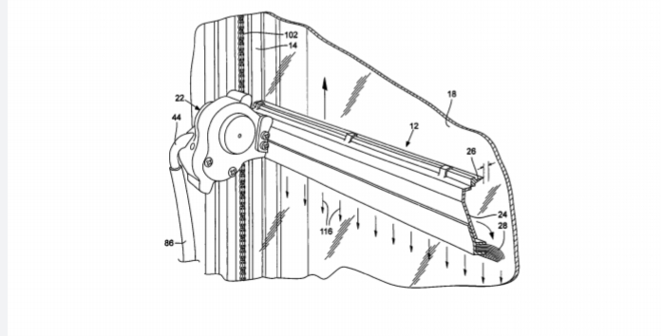
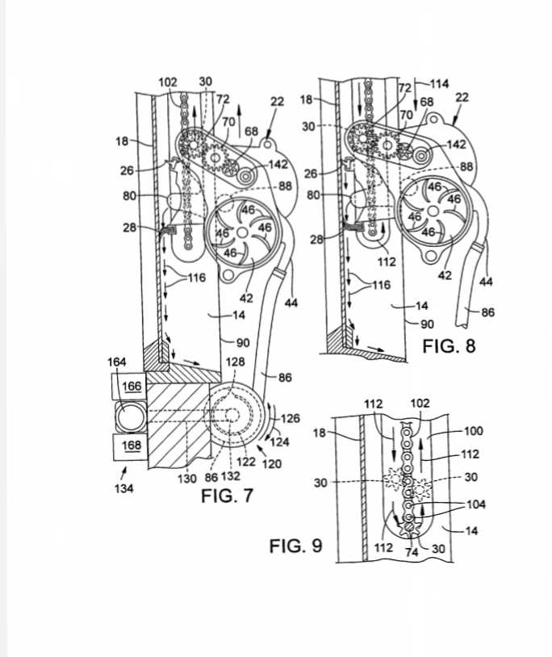
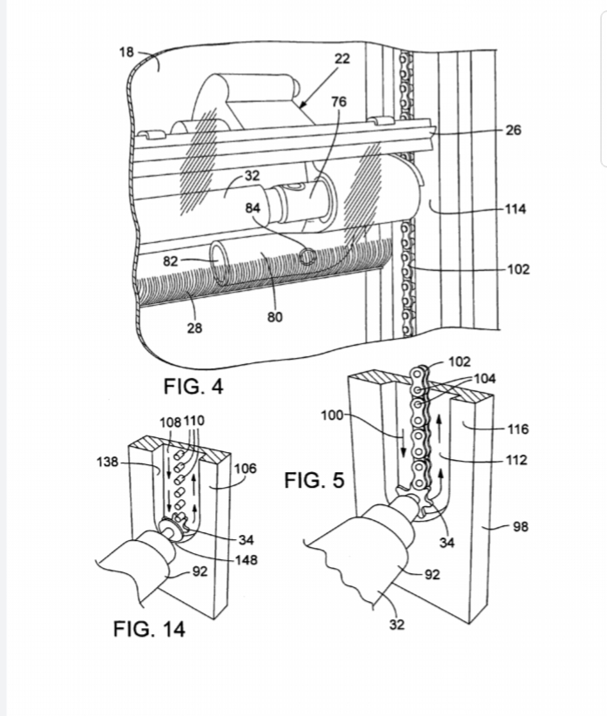
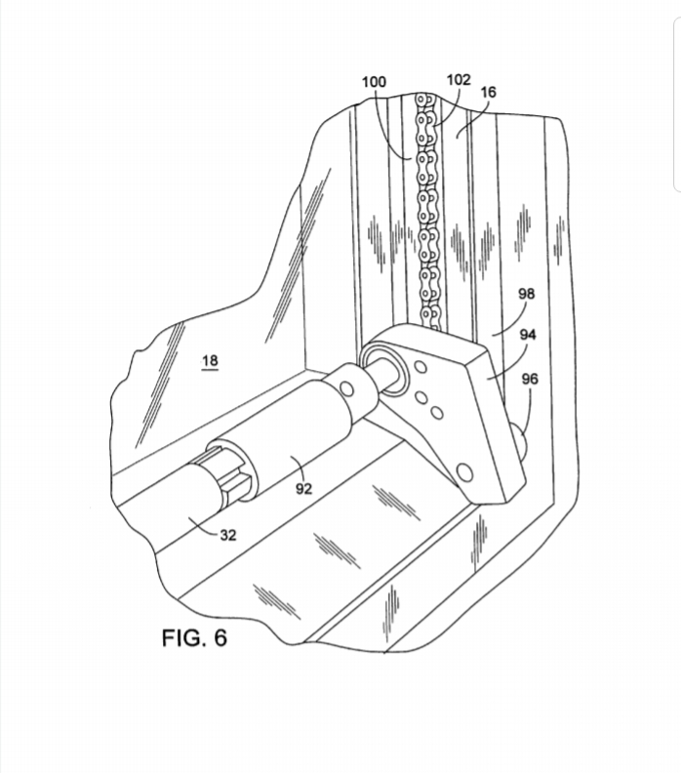
Diagram of Design taken from research paper
source:USpatent No-7503091

Slide 24
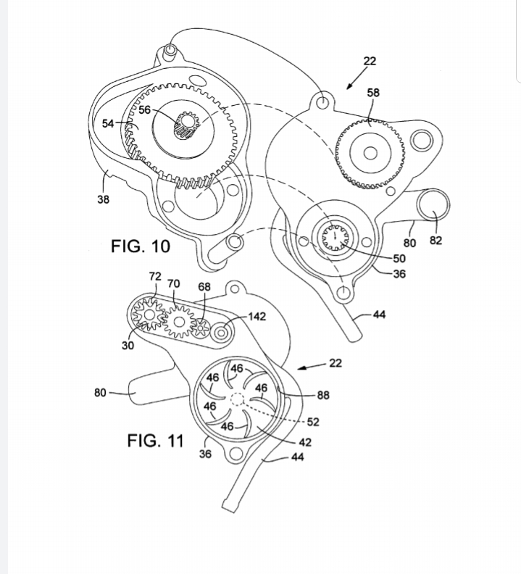
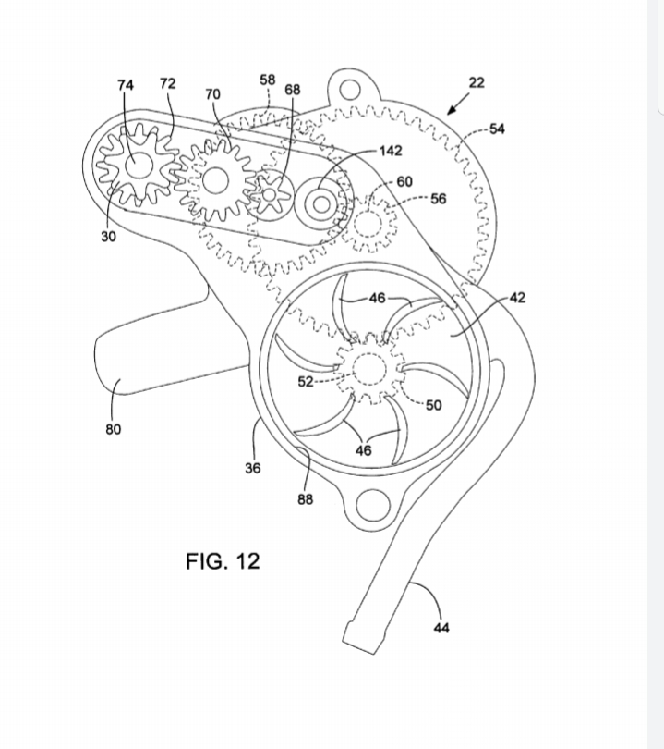
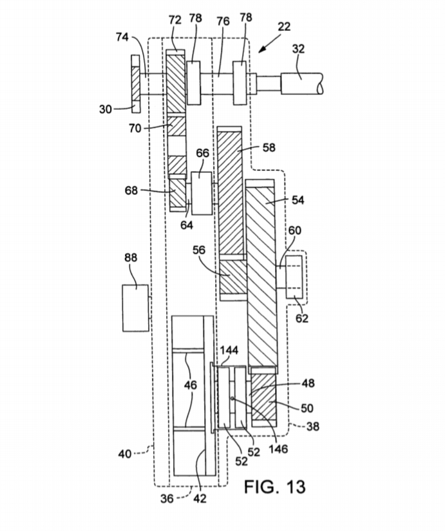
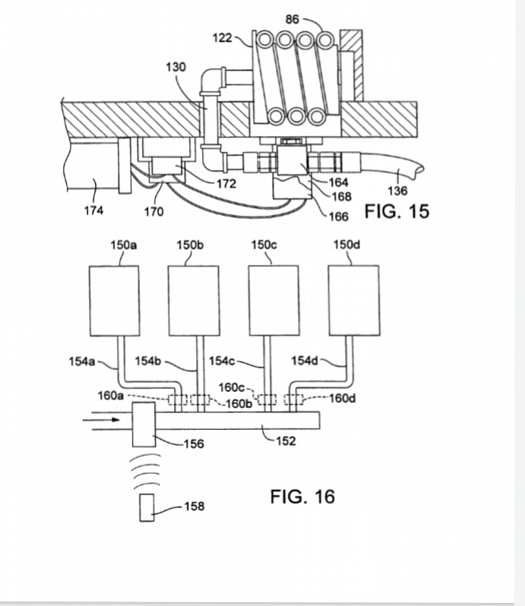
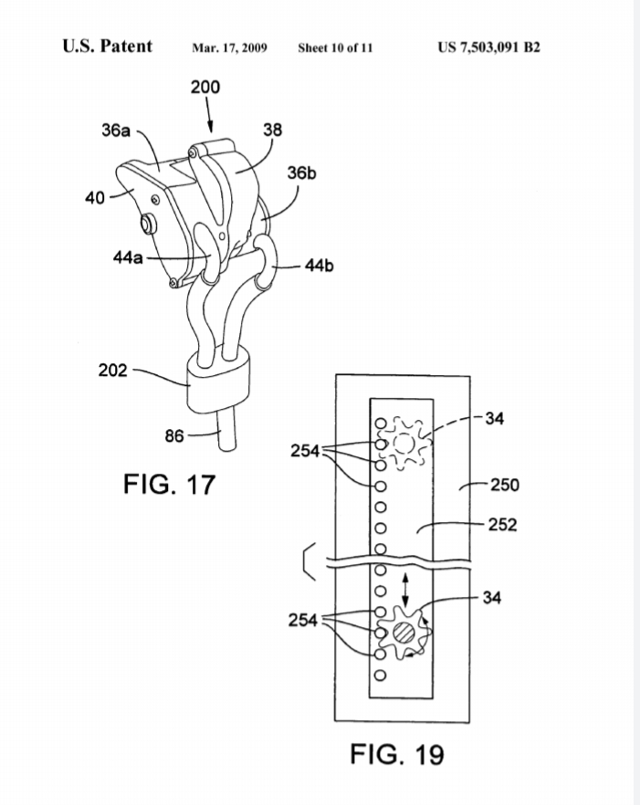
.
source:USpatentNo-7503091

Slide 25
FIG. 1 It is a perspective view of a window cleaning apparatus installed on the exterior casing of a window, according to one embodiment.
FIG.2) It is an enlarged, fragmentary view of a cleaning mechanism of the apparatus Supporting a wiper blade and a brush for cleaning the window.

Slide 26
FIG.3) It is incomplete view of the window cleaning apparatus and window, the wiper blade move away from the window surface

Slide 27
FIG. 12 It is an enlarged, side elevation view of the motor showing the gear assembly housed inside the motor

Slide 28
Approx price
ITEMS. PRICE
Elecric motor- Rs13000
Valves-Rs200
Water pipes-Rs500
Wiper blade-Rs400
Crank shaft-Rs1500
Approx total-Rs15600

Slide 29
THANK YOU!

